Slide 1


10 Reasons to Stop Using Tobacco
Prepared by Health Promotion Naval Medical Center Portsmouth

Slide 2

1. You’ll Feel Better
Right away you will breathe easier and cough less.
Circulation to your feet and hands will improve.
More blood will reach your brain, keeping you mentally strong and reducing the risk of stroke.

Slide 3

2. Your Energy Will Improve
More oxygen (and less carbon monoxide) will reach your heart, lungs and muscles. You’ll fee stronger and have more energy.
You’ll be able to walk farther without running out of breath.
You may even sleep better.

Slide 4

3. You’ll Reduce the
Risk of Illness
Your body will be better able to fight off colds and flu.
Within the first year, your risk of smoking related heart disease will be cut in half.
After 10 years, your risk reduces to that of a non-smoker

Slide 5
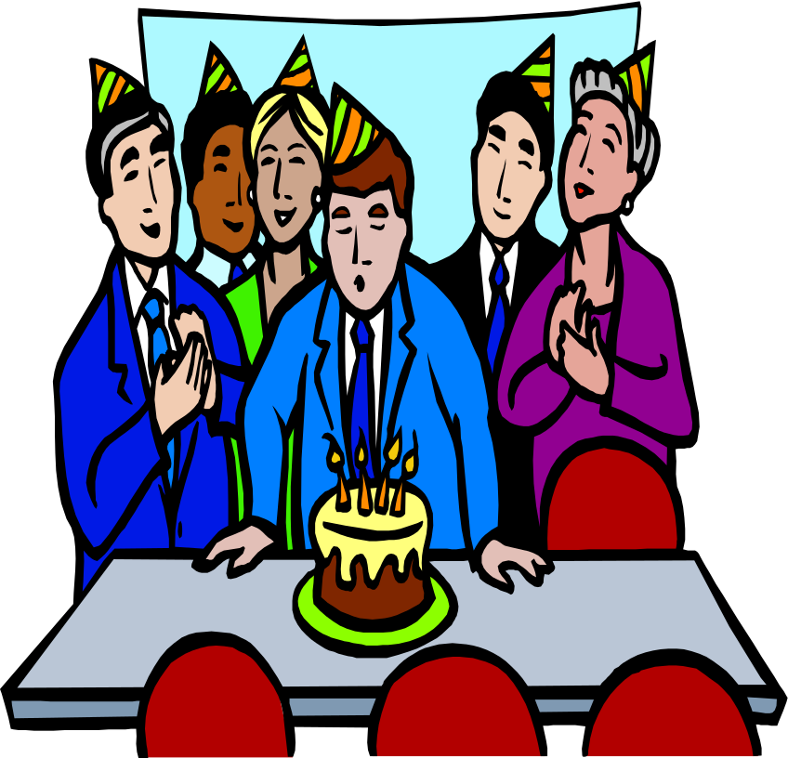
4. You’ll Live Longer
70 percent of seniors who quit smoking live longer than their peers.
With better health you’ll enjoy life more!

Slide 6
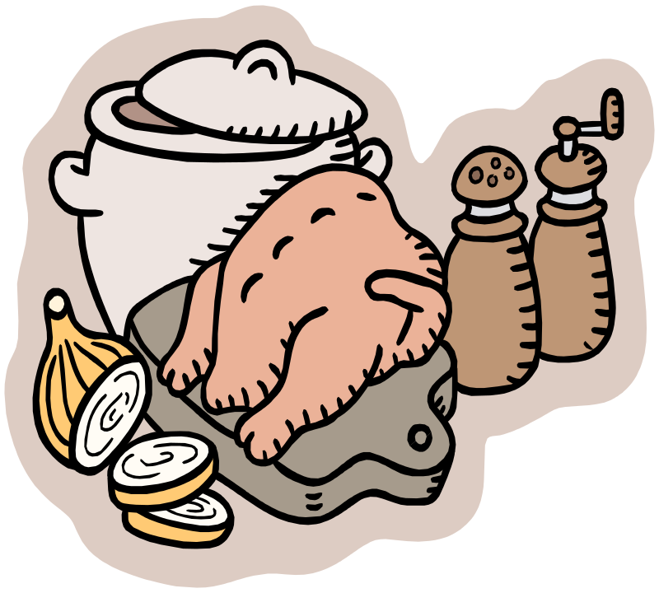
5. Food Will Taste Better
Your sense of smell and taste will return!
Your appetite will improve and you’ll get more enjoyment out of eating!

Slide 7
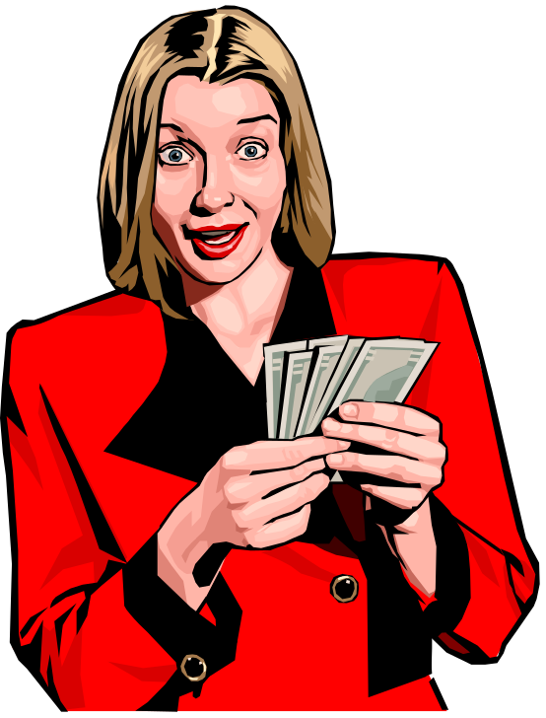
6. You’ll Save Money
Figure out how much money you spend each week on cigarettes.
Multiply that amount by 52 weeks to find out how much you will save each year

Slide 8

7. You’ll Look Better
Your clothes and breath will no longer smell like smoke.
Your teeth will be whiter.
You’ll lose the yellow nicotine stains on your fingers

Slide 9
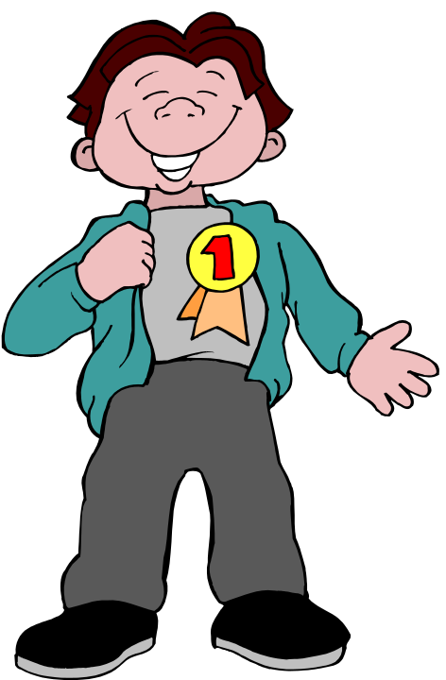
8. Your Self Esteem Will Improve
You will feel more in control of your life.
Your self esteem will improve by knowing you are doing something positive to help yourself!

Slide 10
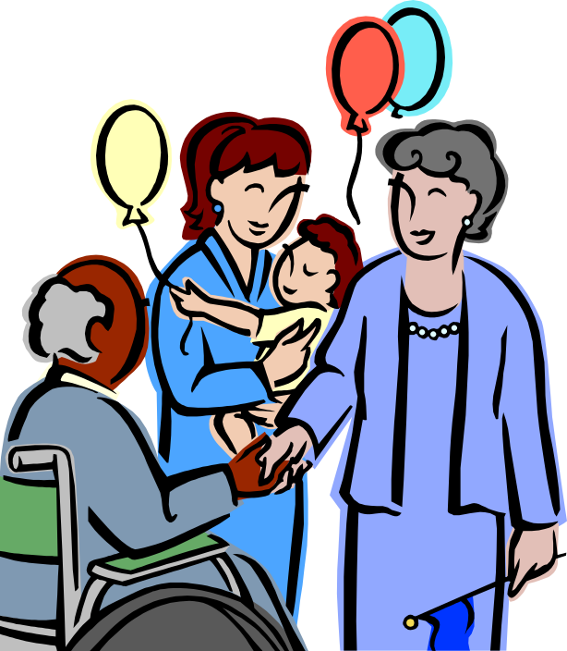
9. You’ll Protect Those You Love
Quitting will reduce the risk of cancer and other serious illnesses to your family
You will reduce illness caused by second hand smoke.
You will set a good example for others!

Slide 11

10. It’s Never Too Late!
If you’ve tried to quit before, you are a step closer to quitting!
Think of past efforts as a learning experience. They have given you the practice and experience to help you succeed now!
I Can Do It!

